Slide 1
Wireless Personal Area Network (WPAN)
Presented by : Shajib Mohammad Saifullah
ID : IT-2104 2 * 4th Year, 1st Semester – ICT, MBSTU *

Slide 2
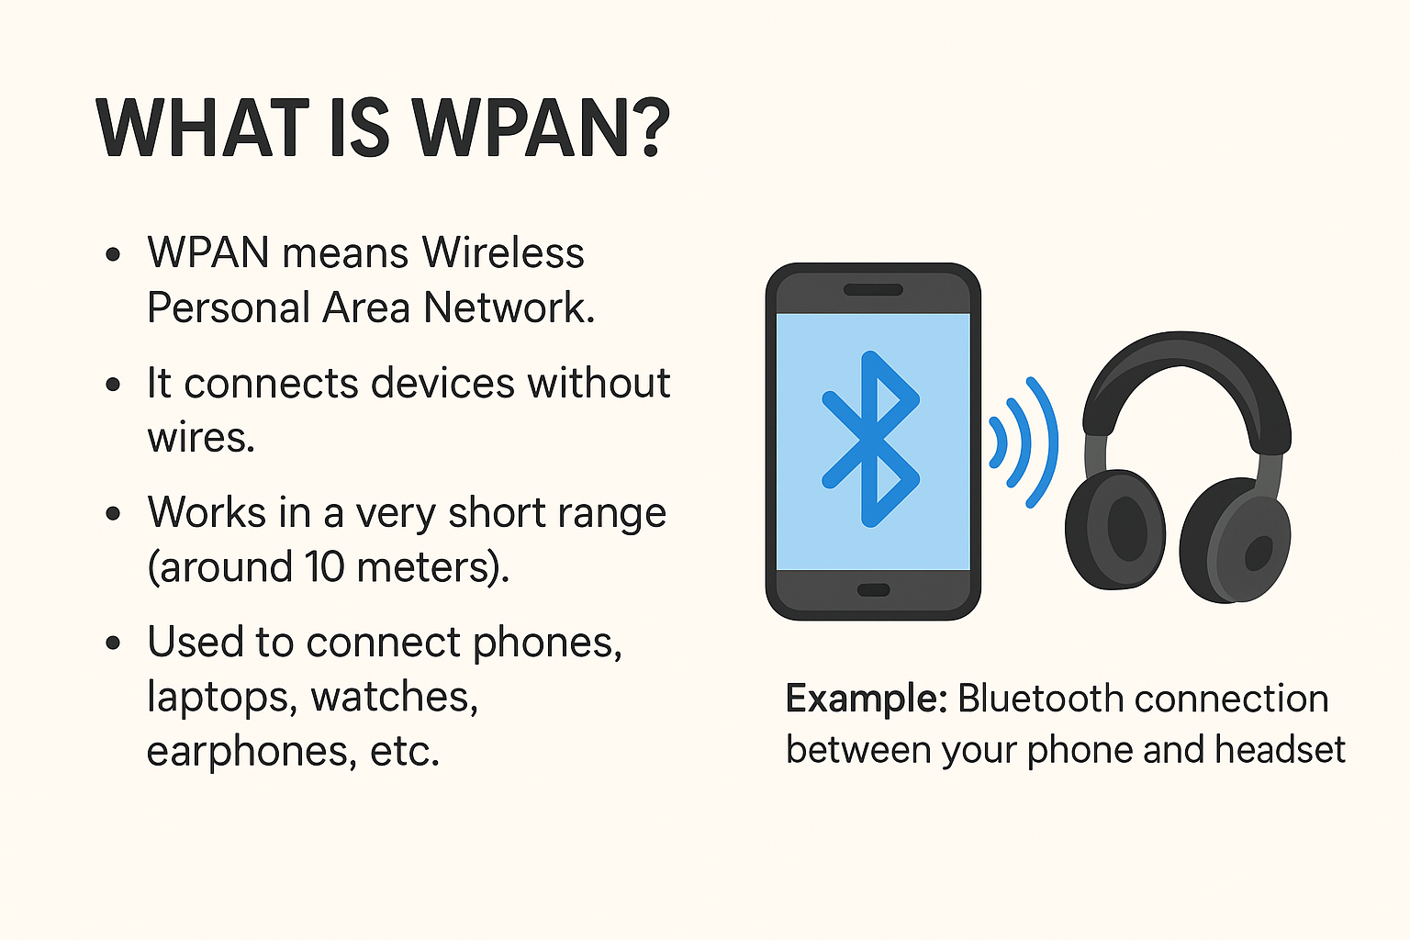

Slide 3
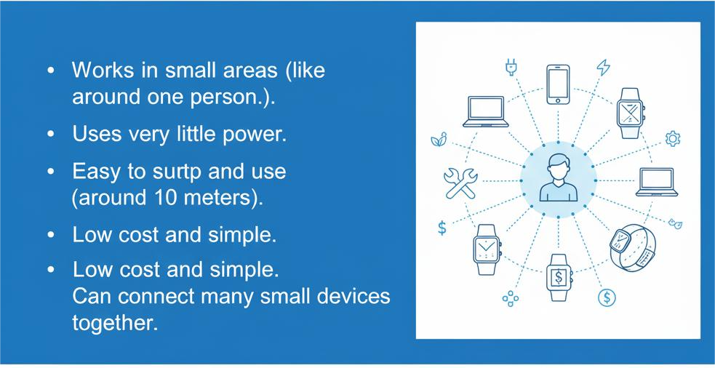
Main Features

Slide 4
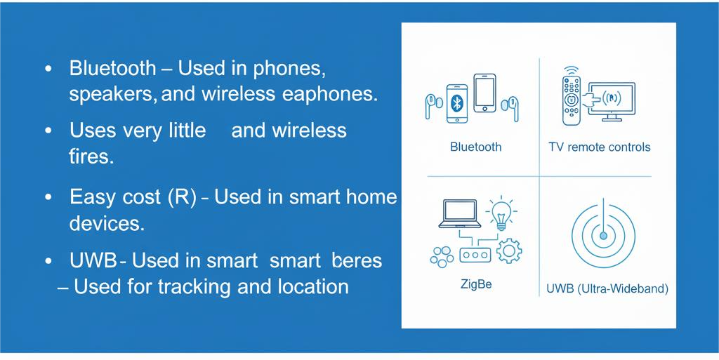
Types of WPAN?

Slide 5
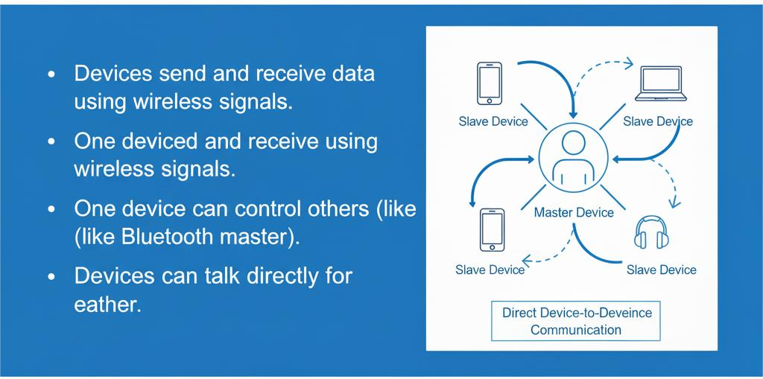
How WPAN Works

Slide 6
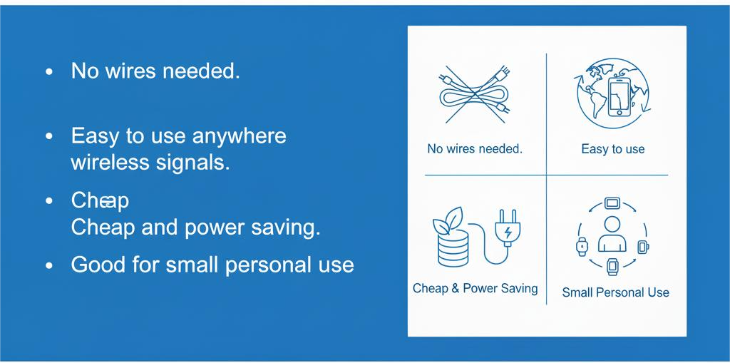
Advantages

Slide 7
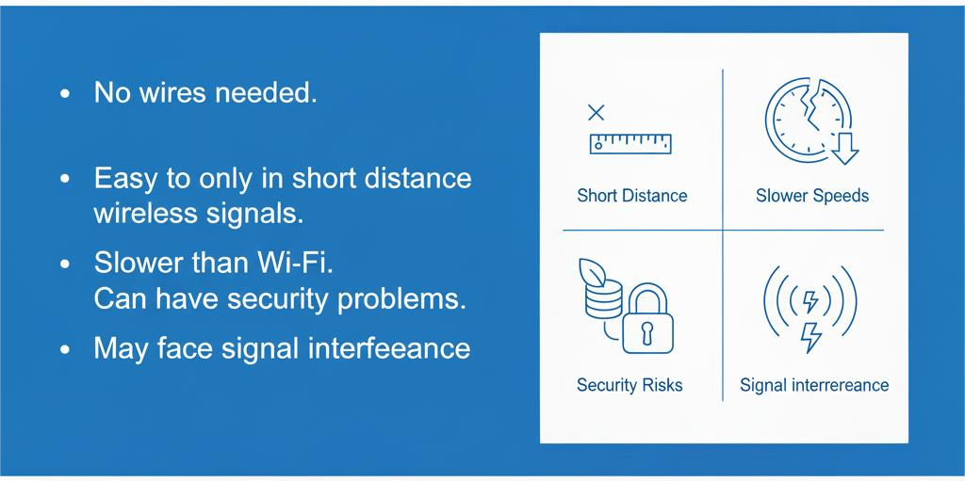
Disadvantages

Slide 8
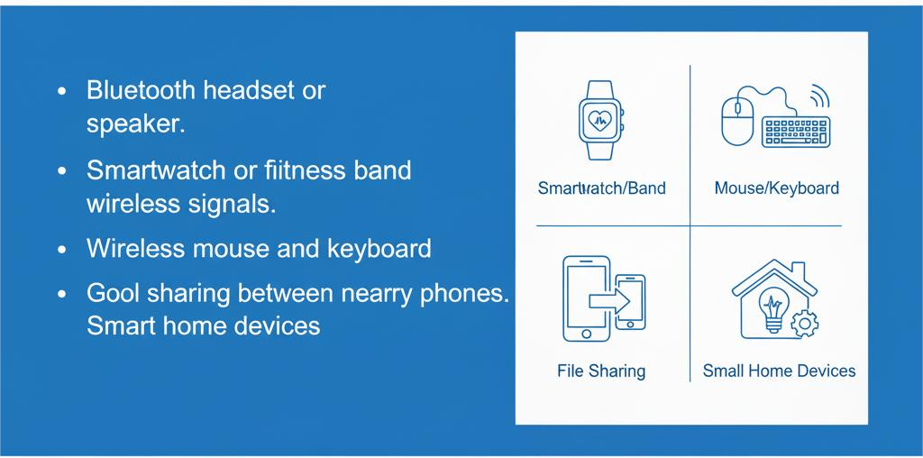
Common Uses

Slide 9
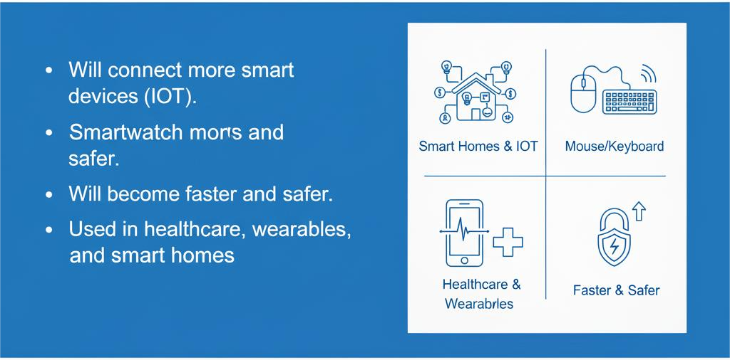
Future of WPAN

Slide 10
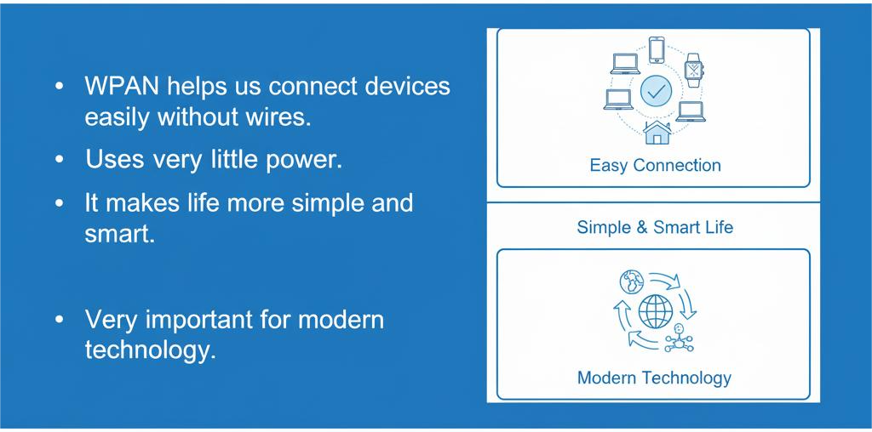
Conclusion

